Slide 1
Noah’s School
A story written just for Noah Rigg

Slide 2
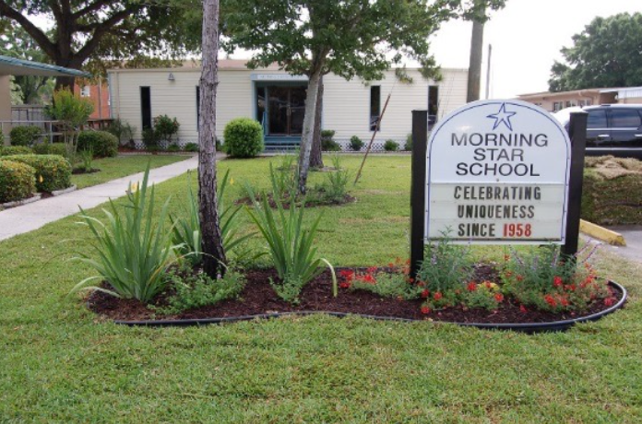
My name is Noah. I have been going to school since I was 3 years old. I went to preschool at Cutler Ridge Christian Academy. I went first, second and third grade at Clark Elementary.
This year for fourth grade, I am going to another school named Morning Star.

Slide 3
At Morning Star, some things will be same like I will still have a teacher. My parents will still drive me to school. I will still eat lunch with my classmates and go to recess. Some things might be a little different. The school is smaller. There will be kids there that want to be my friend. My teachers will help me when I need it.

Slide 4
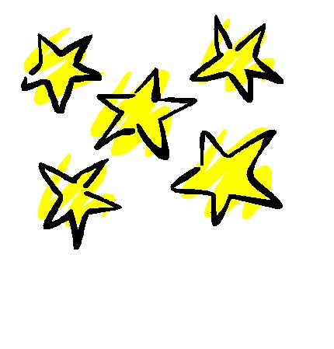
Mom and Dad picked this school just for me because they know I am smart and these teachers know how to teach me. Mom and Dad are going to take pictures of the school for me. I can ask them questions about the school. Some things they will know and some things they can find out.
In August, I will start at Morning Star. I know that some things will be the same and some things will be a little different. I think it will be easier to learn and make friends at Morning Star.

